Slide 1
Foundamentals of Natural Language Processing
Liviu P Dinu
Credits to: Pustejovsky, Jurafsky, Manning, Ray Mooney, David Kauchak, Sudeshna Sarkar, IIT

Slide 2
What is Syntax?
Study of the structure of language
Examine the rules of how words interact and go together
Rules governing grammaticality
I will give you one perspective
  no single correct theory of syntax
  still an active field of research in linguistics
  we will often use it as a tool/stepping stone for other applications

Slide 3
Structure in language
The man all the way home.
what are some examples of words that can/can’t go here?

Slide 4
Structure in language
The man all the way home.
why can’t some words go here?

Slide 5
Structure in language
The man flew all the way home.
Language is bound by a set of rules
It’s not clear exactly the form of these rules, however, people can generally recognize them
This is syntax!
POS Tagging is the lowest level of syntactic analysis

Slide 6
Syntax != Semantics
Colorless green ideas sleep furiously.
Syntax is only concerned with how words interact from a grammatical standpoint, not semantically (i.e. meaning)

Slide 7

Parts of speech
What are parts of speech (think 3rd grade)?

Slide 8
Parts of speech
Parts of speech are constructed by grouping words that function similarly:
- with respect to the words that can occur nearby
- and by their morphological properties
The man all the way home.
ran
forgave
ate
drove
drank
hid
learned
hurt
integrated
programmed
shot
shouted
sat
slept
understood
voted
washed
warned
walked
spoke
succeeded
survived
read
recorded

Slide 9
Parts of Speech
Perhaps starting with Aristotle in the West (384–322 BCE), there was the idea of having parts of speech
  a.k.a lexical categories, word classes, “tags”, POS
It comes from Dionysius Thrax of Alexandria (c. 100 BCE) the idea that is still with us that there are 8 parts of speech
  But actually his 8 aren’t exactly the ones we are taught today
    Thrax: noun, verb, article, adverb, preposition, conjunction, participle, pronoun
    School grammar: noun, verb, adjective, adverb, preposition, conjunction, pronoun, interjection

Slide 10
Closed vs. Open Class
Closed class categories are composed of a small, fixed set of grammatical function words for a given language.
  Pronouns, Prepositions, Modals, Determiners, Particles, Conjunctions
Open class categories have large number of words and new ones are easily invented.
  Nouns (Googler, textlish), Verbs (Google), Adjectives (geeky), Abverb (automagically)

Slide 11
Open class (lexical) words
Nouns
Verbs
Adjectives
old older oldest
Proper
Common
Main
Adverbs
slowly
IBM
Italy
cat / cats
snow
see
registered
Numbers
… more
122,312
one
Closed class (functional)
Modals
Determiners
the some
can
had
Prepositions
to with
Conjunctions
and or
Particles
off up
… more
Pronouns
he its
Interjections
Ow Eh

Slide 12
Open vs. Closed classes
Open vs. Closed classes
  Closed:
    determiners: a, an, the
    pronouns: she, he, I
    prepositions: on, under, over, near, by, …
    Why “closed”?
  Open:
    Nouns, Verbs, Adjectives, Adverbs.
Notes:
Review J&M 2ed Section 5.1

Slide 13
Parts of speech
What are the English parts of speech?
  8 parts of speech?
    Noun (person, place or thing)
    Verb (actions and processes)
    Adjective (modify nouns)
    Adverb (modify verbs)
    Preposition (on, in, by, to, with)
    Determiners (a, an, the, what, which, that)
    Conjunctions (and, but, or)
    Particle (off, up)

Slide 14
English parts of speech
Brown corpus: 87 POS tags
Penn Treebank: ~45 POS tags
  Derived from the Brown tagset
  Most common in NLP
  Many of the examples we’ll show use this one
British National Corpus (C5 tagset): 61 tags
C6 tagset: 148
C7 tagset: 146
C8 tagset: 171
Notes:
tag sets also include tags for punctuation

Slide 15
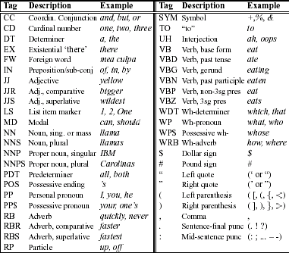
Word Classes: Tag set example
PRP
PRP$

Slide 16
Tagsets
Brown tagset:
https://en.wikipedia.org/wiki/Brown_Corpus
C8 tagset:
http://ucrel.lancs.ac.uk/claws8tags.pdf

Slide 17
English Parts of Speech
Noun (person, place or thing)
  Singular (NN): dog, fork
  Plural (NNS): dogs, forks
  Proper (NNP, NNPS): John, Springfields
  Personal pronoun (PRP): I, you, he, she, they, it
  Wh-pronoun (WP): who, what
Verb (actions and processes)
  Base, infinitive (VB): eat
  Past tense (VBD): ate
  Gerund (VBG): eating
  Past participle (VBN): eaten
  Non 3rd person singular present tense (VBP): eat
  3rd person singular present tense: (VBZ): eats
  Modal (MD): should, can
  To (TO): to (to eat)

Slide 18
English Parts of Speech (cont.)
Adjective (modify nouns)
  Basic (JJ): red, tall
  Comparative (JJR): redder, taller
  Superlative (JJS): reddest, tallest
Adverb (modify verbs)
  Basic (RB): quickly
  Comparative (RBR): quicker
  Superlative (RBS): quickest
Preposition (IN): on, in, by, to, with
Determiner:
  Basic (DT) a, an, the
  WH-determiner (WDT): which, that
Coordinating Conjunction (CC): and, but, or,
Particle (RP): off (took off), up (put up)

Slide 19
Part of speech tagging
Annotate each word in a sentence with a part-of-speech marker
Lowest level of syntactic analysis
John saw the saw and decided to take it to the table.
NNP VBD DT NN CC VBD TO VB PRP IN DT NN

Slide 20
Ambiguity in POS Tagging
  I like candy.
  Time flies like an arrow.
VBP
(verb, non-3rd person, singular, present)
IN
(preposition)
Does “like” play the same role (POS) in these sentences?

Slide 21
Ambiguity in POS Tagging
  I bought it at the shop around the corner.
  I never got around to getting the car.
  The cost of a new Prius is around $25K.
IN
(preposition)
RP
(particle… on, off)
RB
(adverb)
Does “around” play the same role (POS) in these sentences?

Slide 22
Ambiguity in POS tagging
Like most language components, the challenge with POS tagging is ambiguity
Brown corpus analysis
  11.5% of word types are ambiguous (this sounds promising!), but…
  40% of word appearances are ambiguous
  Unfortunately, the ambiguous words tend to be the more frequently used words

Slide 23
How hard is it?
If I told you had a POS tagger that achieved 90% accuracy would you be impressed?
  Shouldn’t be… just picking the most frequent POS for a word gets you this
What about a POS tagger that achieves 93.7%?
  Still probably shouldn’t be… only need to add a basic module for handling unknown words
What about a POS tagger that achieves 100%?
  Should be suspicious… humans only achieve ~97%
  Probably overfitting (or cheating!)

Slide 24
POS Tagging Approaches
Rule-Based: Human crafted rules based on lexical and other linguistic knowledge
Learning-Based: Trained on human annotated corpora like the Penn Treebank
  Statistical models: Hidden Markov Model (HMM), Maximum Entropy Markov Model (MEMM), Conditional Random Field (CRF), log-linear models, support vector machines (SVMs), neural networks
  Rule learning: Transformation Based Learning (TBL)
The book discusses some of the more common approaches
Many publicly available:
  http://nlp.stanford.edu/links/statnlp.html
  (list 15 different ones mostly publicly available!)
  http://www.coli.uni-saarland.de/~thorsten/tnt/

Slide 25
POS Tagging
Task:
  assign the right part-of-speech tag, e.g. noun, verb, conjunction, to a word in context
POS taggers
  need to be fast in order to process large corpora
    should take no more than time linear in the size of the corpora
  full parsing is slow
    e.g. context-free grammar ≈ n³, n length of the sentence
  POS taggers try to assign correct tag without actually parsing the sentence
Lecture 1, 7/21/2005
Natural Language Processing

Slide 26
POS Tagging
Components:
  Dictionary of words
    Exhaustive list of closed class items
      Examples:
        the, a, an: determiner
        from, to, of, by: preposition
        and, or: coordination conjunction
    Large set of open class (e.g. noun, verbs, adjectives) items with frequency information
Lecture 1, 7/21/2005
Natural Language Processing

Slide 27
POS Tagging
Components:
  Mechanism to assign tags
    Context-free: by frequency
    Context: bigram, trigram, HMM, hand-coded rules
      Example:
        Det Noun/*Verb the walk…
  Mechanism to handle unknown words (extra-dictionary)
    Capitalization
    Morphology: -ed, -tion
Lecture 1, 7/21/2005
Natural Language Processing

Slide 28
POS Tagging
Words often have more than one POS: back
  The back door = JJ
  On my back = NN
  Win the voters back = RB
  Promised to back the bill = VB
The POS tagging problem is to determine the POS tag for a particular instance of a word.
These examples from Dekang Lin
Lecture 1, 7/21/2005
Natural Language Processing

Slide 29
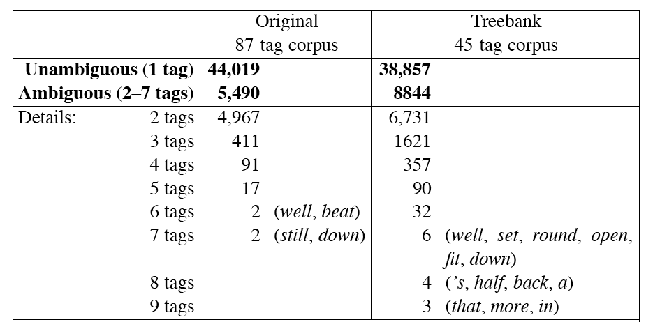
How hard is POS tagging? Measuring ambiguity
Lecture 1, 7/21/2005
Natural Language Processing

Slide 30
Algorithms for POS Tagging
  Ambiguity – In the Brown corpus, 11.5% of the word types are ambiguous (using 87 tags):
  Worse, 40% of the tokens are ambiguous.
Lecture 1, 7/21/2005
Natural Language Processing

Slide 31
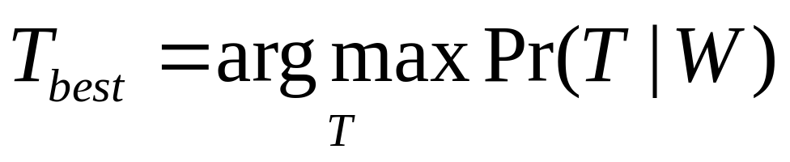
Problem Setup
There are M types of POS tags
  Tag set: {t₁,..,t_{M}}.
The word vocabulary size is V
  Vocabulary set: {w₁,..,w_{V}}.
We have a word sequence of length n:
W = w₁,w₂…w_{n}
Want to find the best sequence of POS tags:
  T = t₁,t₂…t_{n}
Lecture 1, 7/21/2005
Natural Language Processing

Slide 32
Sourcce of Information
What are the main sources of information for POS tagging?
Knowledge of neighboring words
  Bill saw that man yesterday
  NNP NN DT NN NN VB VB(D) IN VB NN
Knowledge of word probabilities
  man is rarely used as a verb….
The latter proves the most useful, but the former also helps

Slide 33
Information sources for tagging
All techniques are based on the same observations…
some tag sequences are more probable than others
    ART+ADJ+N is more probable than ART+ADJ+VB
Lexical information: knowing the word to be tagged gives a lot of information about the correct tag
    “table”: {noun, verb} but not a {adj, prep,…}
    “rose”: {noun, adj, verb} but not {prep, ...}
Lecture 1, 7/21/2005
Natural Language Processing

Slide 34
Algorithms for POS Tagging
Why can’t we just look them up in a dictionary?
  Words that aren’t in the dictionary
http://story.news.yahoo.com/news?tmpl=story&cid=578&ncid=578&e=1&u=/nm/20030922/ts_nm/iraq_usa_dc
One idea: P(t_{i} | w_{i}) = the probability that a random hapax legomenon in the corpus has tag t_{i}.
  Nouns are more likely than verbs, which are more likely than pronouns.
Another idea: use morphology.
Natural Language Processing

Slide 35
Algorithms for POS Tagging - Knowledge
Dictionary
Morphological rules, e.g.,
  _____-tion
  _____-ly
  capitalization
N-gram frequencies
  to _____
  DET _____ N
  But what about rare words, e.g, smelt (two verb forms, melt and past tense of smell, and one noun form, a small fish)
Combining these
  V _____-ing I was gracking vs. Gracking is fun.
Natural Language Processing

Slide 36
POS Tagging - Approaches
Approaches
  Rule-based tagging
    (ENGTWOL)
  Stochastic (=Probabilistic) tagging
    HMM (Hidden Markov Model) tagging
  Transformation-based tagging
    Brill tagger
Do we return one best answer or several answers and let later steps decide?
How does the requisite knowledge get entered?
Natural Language Processing

Slide 37
3 methods for POS tagging
1. Rule-based tagging
  Example: Karlsson (1995) EngCG tagger based on the Constraint Grammar architecture and ENGTWOL lexicon
    Basic Idea:
      Assign all possible tags to words (morphological analyzer used)
      Remove wrong tags according to set of constraint rules (typically more than 1000 hand-written constraint rules, but may be machine-learned)
Natural Language Processing

Slide 38
Sample rules
N-IP rule:
  A tag N (noun) cannot be followed by a tag IP (interrogative pronoun)
  ... man who …
    man: {N}
    who: {RP, IP} --> {RP} relative pronoun
ART-V rule:
  A tag ART (article) cannot be followed by a tag V (verb)
  ...the book…
    the: {ART}
    book: {N, V} --> {N}
Natural Language Processing

Slide 39
After The First Stage
Example: He had a book.
After the fırst stage:
  he he/pronoun
  had have/verbpast have/auxliarypast
  a a/article
  book book/noun book/verb
Tagging Rule
Rule-1:
if (the previous tag is an article)
then eliminate all verb tags
Rule-2:
if (the next tag is verb)
then eliminate all verb tags
Natural Language Processing

Slide 40
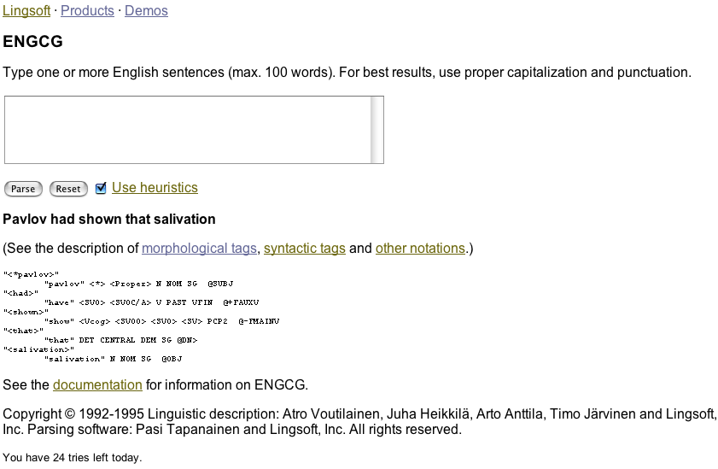
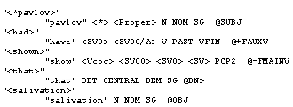
Rule-Based POS Tagging
ENGTWOL tagger (now ENGCG-2)
  http://www.lingsoft.fi/cgi-bin/engcg
Lecture 1, 7/21/2005
Natural Language Processing

Slide 41
Rule-Based Tagging
Basic Idea:
  Assign all possible tags to words
  Remove tags according to set of rules of type: if word+1 is an adj, adv, or quantifier and the following is a sentence boundary and word-1 is not a verb like “consider” then eliminate non-adv else eliminate adv.
  Typically more than 1000 hand-written rules

Slide 42
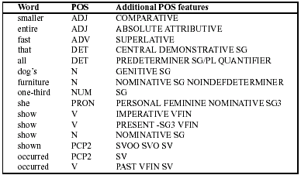
Sample ENGTWOL Lexicon
  Demo: http://www2.lingsoft.fi/cgi-bin/engtwol

Slide 43
Stage 1 of ENGTWOL Tagging
First Stage: Run words through a morphological analyzer to get all parts of speech.
Example: Pavlov had shown that salivation …
Pavlov PAVLOV N NOM SG PROPER
had HAVE V PAST VFIN SVO
HAVE PCP2 SVO
shown SHOW PCP2 SVOO SVO SV
that ADV
PRON DEM SG
DET CENTRAL DEM SG
CS
salivation N NOM SG

Slide 44
Stage 2 of ENGTWOL Tagging
Second Stage: Apply constraints.
Constraints used in negative way.
Example: Adverbial “that” rule
Given input: “that”
If
(+1 A/ADV/QUANT)
(+2 SENT-LIM)
(NOT -1 SVOC/A)
Then eliminate non-ADV tags
Else eliminate ADV

Slide 45
MULTUMESC!
Tesekkur ederim!

Slide 46
Foundamentals of Natural Language Processing
Liviu P Dinu
Credits to: Pustejovsky, Jurafsky, Manning, Ray Mooney, David Kauchak, Sudeshna Sarkar, IIT

Slide 47
Stochastic Tagging
Based on probability of certain tag occurring given various possibilities
Requires a training corpus
No probabilities for words not in corpus.

Slide 48
Stochastic Tagging (cont.)
Simple Method: Choose most frequent tag in training text for each word!
  Result: 90% accuracy
  Baseline
  Others will do better
  HMM is an example

Slide 49
HMM Tagger
Intuition: Pick the most likely tag for this word.
Let T = t₁,t₂,…,t_{n}
Let W = w₁,w₂,…,w_{n}
Find POS tags that generate a sequence of words, i.e., look for most probable sequence of tags T underlying the observed words W.

Slide 50
Toward a Bigram-HMM Tagger
argmax_{T} P(T|W)
argmax_{T}P(T)P(W|T)
argmax_{t}P(t₁…t_{n})P(w₁…w_{n}|t₁…t_{n})
argmax_{t}[P(t₁)P(t₂|t₁)…P(t_{n}|t_{n-1})][P(w₁|t₁)P(w₂|t₂)…P(w_{n}|t_{n})]
To tag a single word: t_{i} = argmax_{j} P(t_{j}|t_{i-1})P(w_{i}|t_{j})
How do we compute P(t_{i}|t_{i-1})?
  c(t_{i-1}t_{i})/c(t_{i-1})
How do we compute P(w_{i}|t_{i})?
  c(w_{i},t_{i})/c(t_{i})
How do we compute the most probable tag sequence?
  Viterbi

Slide 51
3 methods for POS tagging
Stochastic (=Probabilistic) tagging
Assume that a word’s tag only depends on the previous tags (not following ones)
Use a training set (manually tagged corpus) to:
  learn the regularities of tag sequences
  learn the possible tags for a word
  model this info through a language model (n-gram)
  Example: HMM (Hidden Markov Model) tagging - a training corpus used to compute the probability (frequency) of a given word having a given POS tag in a given context
Natural Language Processing

Slide 52
Probabilities
Natural Language Processing

Slide 53
Topics
Probability
Conditional Probability
Independence
Bayes Rule
HMM tagging
Markov Chains
Hidden Markov Models
Natural Language Processing

Slide 54
6. Introduction to Probability
Experiment (trial)
  Repeatable procedure with well-defined possible outcomes
Sample Space (S)
    the set of all possible outcomes
    finite or infinite
  Example
    coin toss experiment
    possible outcomes: S = {heads, tails}
  Example
    die toss experiment
    possible outcomes: S = {1,2,3,4,5,6}
Natural Language Processing

Slide 55
Introduction to Probability
Definition of sample space depends on what we are asking
  Sample Space (S): the set of all possible outcomes
  Example
    die toss experiment for whether the number is even or odd
    possible outcomes: {even,odd}
    not {1,2,3,4,5,6}
Natural Language Processing

Slide 56
More definitions
Events
  an event is any subset of outcomes from the sample space
Example
  die toss experiment
  let A represent the event such that the outcome of the die toss experiment is divisible by 3
  A = {3,6}
  A is a subset of the sample space S= {1,2,3,4,5,6}
Natural Language Processing

Slide 57
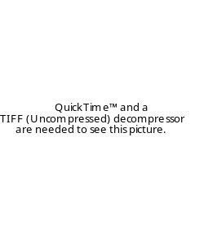
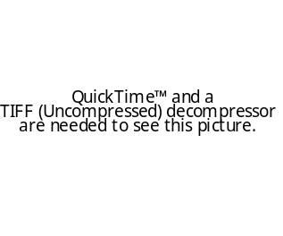
Introduction to Probability
Some definitions
  Events
    an event is a subset of sample space
    simple and compound events
  Example
    deck of cards draw experiment
    suppose sample space S = {heart,spade,club,diamond} (four suits)
    let A represent the event of drawing a heart
    let B represent the event of drawing a red card
    A = {heart} (simple event)
    B = {heart} u {diamond} = {heart,diamond} (compound event)
      a compound event can be expressed as a set union of simple events
  Example
    alternative sample space S = set of 52 cards
    A and B would both be compound events
Natural Language Processing

Slide 58
Introduction to Probability
Some definitions
  Counting
    suppose an operation o_{i} can be performed in n_{i} ways,
    a set of k operations o₁o₂...o_{k} can be performed in n₁ × n₂ × ... × n_{k} ways
  Example
    dice toss experiment, 6 possible outcomes
    two dice are thrown at the same time
    number of sample points in sample space = 6 × 6 = 36
Natural Language Processing

Slide 59
Definition of Probability
The probability law assigns to an event a nonnegative number
Called P(A)
Also called the probability A
That encodes our knowledge or belief about the collective likelihood of all the elements of A
Probability law must satisfy certain properties
Natural Language Processing

Slide 60
Probability Axioms
Nonnegativity
  P(A) >= 0, for every event A
Additivity
  If A and B are two disjoint events, then the probability of their union satisfies:
  P(A U B) = P(A) + P(B)
Normalization
  The probability of the entire sample space S is equal to 1, i.e. P(S) = 1.
Natural Language Processing

Slide 61
An example
An experiment involving a single coin toss
There are two possible outcomes, H and T
Sample space S is {H,T}
If coin is fair, should assign equal probabilities to 2 outcomes
Since they have to sum to 1
P({H}) = 0.5
P({T}) = 0.5
P({H,T}) = P({H})+P({T}) = 1.0
Natural Language Processing

Slide 62
Another example
Experiment involving 3 coin tosses
Outcome is a 3-long string of H or T
S ={HHH,HHT,HTH,HTT,THH,THT,TTH,TTT}
Assume each outcome is equiprobable
  “Uniform distribution”
What is probability of the event that exactly 2 heads occur?
A = {HHT,HTH,THH} 3 events/outcomes
P(A) = P({HHT})+P({HTH})+P({THH}) additivity - union of the probability of the individual events
= 1/8 + 1/8 + 1/8 total 8 events/outcomes
= 3/8
Natural Language Processing

Slide 63


Probability definitions
In summary:
  Probability of drawing a spade from 52 well-shuffled playing cards:
Natural Language Processing

Slide 64
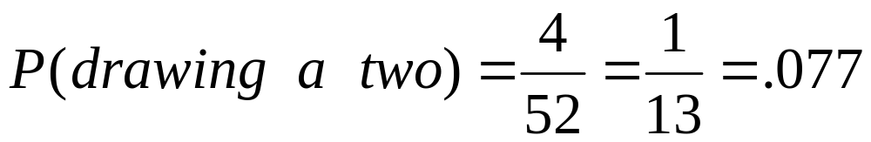
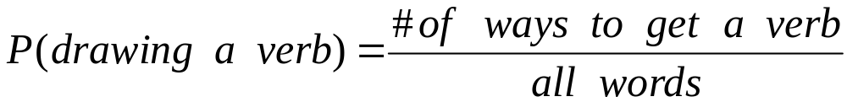
Moving toward language
What’s the probability of drawing a 2 from a deck of 52 cards with four 2s?
What’s the probability of a random word (from a random dictionary page) being a verb?
Natural Language Processing

Slide 65
Probability and part of speech tags
What’s the probability of a random word (from a random dictionary page) being a verb?
How to compute each of these
All words = just count all the words in the dictionary
# of ways to get a verb: # of words which are verbs!
If a dictionary has 50,000 entries, and 10,000 are verbs…. P(V) is 10000/50000 = 1/5 = .20
Natural Language Processing

Slide 66
Conditional Probability
A way to reason about the outcome of an experiment based on partial information
  In a word guessing game the first letter for the word is a “t”. What is the likelihood that the second letter is an “h”?
  How likely is it that a person has a disease given that a medical test was negative?
  A spot shows up on a radar screen. How likely is it that it corresponds to an aircraft?
Natural Language Processing

Slide 67
More precisely
Given an experiment, a corresponding sample space S, and a probability law
Suppose we know that the outcome is some event B
We want to quantify the likelihood that the outcome also belongs to some other event A
We need a new probability law that gives us the conditional probability of A given B
P(A|B)
Natural Language Processing

Slide 68
An intuition
Let’s say A is “it’s raining”.
Let’s say P(A) in Kharagpur is 0.2
Let’s say B is “it was sunny ten minutes ago”
P(A|B) means “what is the probability of it raining now if it was sunny 10 minutes ago”
P(A|B) is probably way less than P(A)
Perhaps P(A|B) is .0001
Intuition: The knowledge about B should change our estimate of the probability of A.
Natural Language Processing

Slide 69
Conditional Probability
let A and B be events in the sample space
P(A|B) = the conditional probability of event A occurring given some fixed event B occurring
definition: P(A|B) = P(A ∩ B) / P(B)
Natural Language Processing

Slide 70
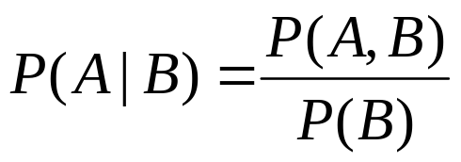
Conditional probability
P(A|B) = P(A ∩ B)/P(B)
Or
Note: P(A,B)=P(A|B) · P(B)
Also: P(A,B) = P(B,A)
A
A,B
B
Natural Language Processing

Slide 71
Independence
What is P(A,B) if A and B are independent?
P(A,B)=P(A) · P(B) iff A,B independent.
  P(heads,tails) = P(heads) · P(tails) = .5 · .5 = .25
  Note: P(A|B)=P(A) iff A,B independent
  Also: P(B|A)=P(B) iff A,B independent
Natural Language Processing

Slide 72
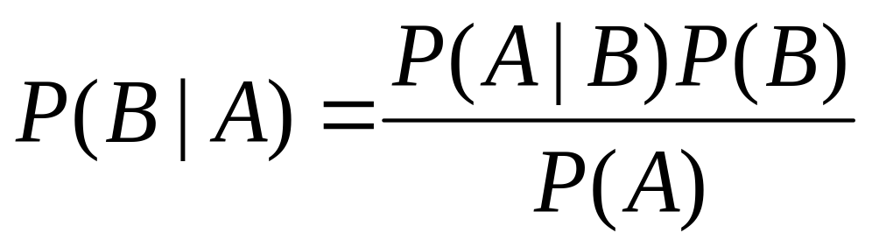
Bayes Theorem
Idea: The probability of an A conditional on another event B is generally different from the probability of B conditional on A. There is a definite relationship between the two.
Natural Language Processing

Slide 73
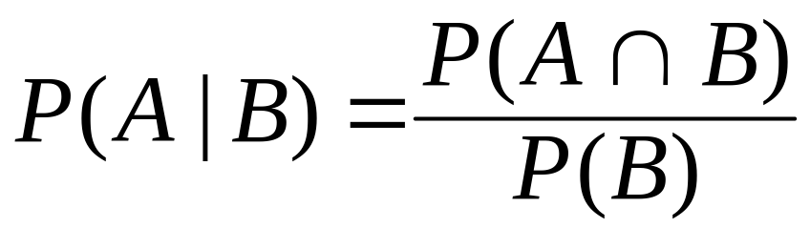
Deriving Bayes Rule
The probability of event A given event B is
Natural Language Processing

Slide 74
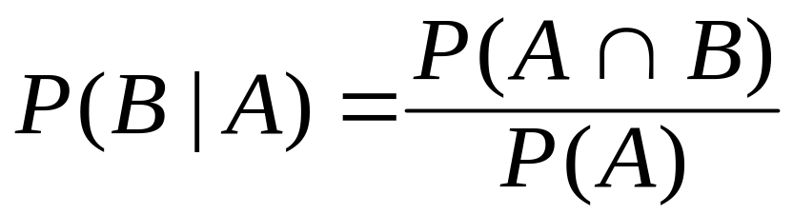
Deriving Bayes Rule
The probability of event B given event A is
Natural Language Processing

Slide 75


Deriving Bayes Rule
Natural Language Processing

Slide 76
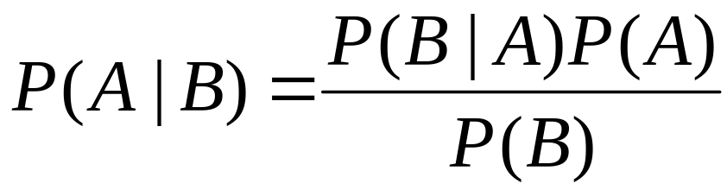
Deriving Bayes Rule
Natural Language Processing

Slide 77
Deriving Bayes Rule
the theorem may be paraphrased as
conditional/posterior probability =
(LIKELIHOOD multiplied by PRIOR) divided by NORMALIZING CONSTANT
Natural Language Processing

Slide 78
Hidden Markov Model (HMM) Tagging
Using an HMM to do POS tagging
HMM is a special case of Bayesian inference
It is also related to the “noisy channel” model in ASR (Automatic Speech Recognition)
Natural Language Processing

Slide 79
Hidden Markov Model (HMM) Taggers
Goal: maximize P(word|tag) x P(tag|previous n tags)
P(word|tag)
  word/lexical likelihood
  probability that given this tag, we have this word
  NOT probability that this word has this tag
  modeled through language model (word-tag matrix)
P(tag|previous n tags)
  tag sequence likelihood
  probability that this tag follows these previous tags
  modeled through language model (tag-tag matrix)
Lexical information
Syntagmatic information
Natural Language Processing

Slide 80
POS tagging as a sequence classification task
We are given a sentence (an “observation” or “sequence of observations”)
  Secretariat is expected to race tomorrow
  sequence of n words w1…wn.
What is the best sequence of tags which corresponds to this sequence of observations?
Probabilistic/Bayesian view:
  Consider all possible sequences of tags
  Out of this universe of sequences, choose the tag sequence which is most probable given the observation sequence of n words w1…wn.
Natural Language Processing

Slide 81

Getting to HMM
Let T = t₁,t₂,…,t_{n}
Let W = w₁,w₂,…,w_{n}
Goal: Out of all sequences of tags t₁…t_{n}, get the the most probable sequence of POS tags T underlying the observed sequence of words w₁,w₂,…,w_{n}
Hat ^ means “our estimate of the best = the most probable tag sequence”
Argmax_{x} f(x) means “the x such that f(x) is maximized”
it maximazes our estimate of the best tag sequence
Natural Language Processing

Slide 82
Getting to HMM
This equation is guaranteed to give us the best tag sequence
But how do we make it operational? How do we compute this value?
Intuition of Bayesian classification:
  Use Bayes rule to transform it into a set of other probabilities that are easier to compute
  Thomas Bayes: British mathematician (1702-1761)
Natural Language Processing

Slide 83
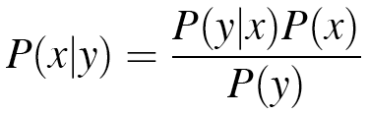
Bayes Rule
Breaks down any conditional probability P(x|y) into three other probabilities
P(x|y): The conditional probability of an event x assuming that y has occurred
Natural Language Processing

Slide 84
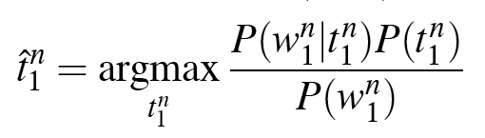
Bayes Rule
We can drop the denominator: it does not change for each tag sequence; we are looking for the best tag sequence for the same observation, for the same fixed set of words

Slide 85
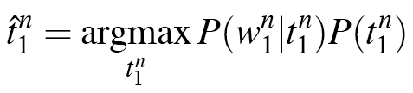
Bayes Rule
Natural Language Processing

Slide 86
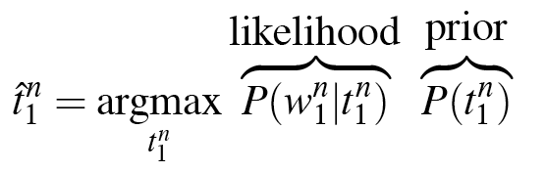
Likelihood and prior
n
Natural Language Processing

Slide 87
Statistical Tagging
Statistical (or stochastic) taggers use a training corpus to compute the probability of a tag in a context.
For a given word sequence, Hidden Markov Model (HMM) Taggers choose the tag sequence that maximixes
P(word | tag) * P(tag | previous-n-tags)
A bigram HMM tagger chooses the tag t_{i} for word w_{i} that is most probable given the previous tag, t_{i-1}
t_{i} = argmax_{j} P(t_{j} | t_{i-1}, w_{i})

Slide 88
Statistical POS Tagging (Allen95)
Let’s step back a minute and remember some probability theory and its use in POS tagging.
Suppose, with no context, we just want to know given the word “flies” whether it should be tagged as a noun or as a verb.
We use conditional probability for this: we want to know which is greater
  PROB(N | flies) or PROB(V | flies)
Note definition of conditional probability
  PROB(a | b) = PROB(a & b) / PROB(b)
  Where PROB(a & b) is the probability of the two events a dn b occurring simultaneously

Slide 89
Calculating POS for “flies”
We need to know which is more
PROB(N | flies) = PROB(flies & N) / PROB(flies)
PROB(V | flies) = PROB(flies & V) / PROB(flies)
Count on a Corpus

Slide 90
Corpus to Estimate
1,273,000 words; 1000 uses of flies; 400 flies in N sense; 600 flies in V sense
PROB(flies) ≈ 1000/1,273,000 = .0008
PROB(flies & N) ≈ 400/1,273,000 = .0003
PROB(flies & V) ≈ 600/1,273,000 = .0005
Out best guess is that flies is a V
PROB(V | flies) = PROB(V & flies) / PROB(flies)
= .0005/.0008 = .625

Slide 91
Doing Better
Simple Method: Always choose the tag that appears most frequently in the training set – will work correctly about 91% of the time.
How to do better: Consider more of the context. Knowing “the flies” gives much higher probability of a Noun
General Equation: find the sequence of tags that maximizes:
PROB(T₁,…T_{n} | w₁,…w_{n})

Slide 92
Estimating Too Hard
PROB(T₁,…T_{n} | w₁,…w_{n})
Estimating the above takes far too much data. Need to do some reasonable approximations.
Bayes Rule:
PROB(A | B) = PROB(B | A) * PROB(A) / PROB(B)
Rewriting:
PROB(w₁,…w_{n} | T₁,…T_{n}) * PROB(T₁,…T_{n}) / PROB(w₁,…w_{n})

Slide 93
PROB(w₁,…w_{n} | T₁,…T_{n}) * PROB(T₁,…T_{n}) / PROB(w₁,…w_{n})
Remember we are interested in finding the sequence of tags that maximizes this formula – so we can ignore PROB(w₁,…w_{n}) since it is always the same
So, we want to find the sequence of tags that maximizes
PROB(w₁,…w_{n} | T₁,…T_{n}) * PROB(T₁,…T_{n})
This is still too hard to calculate – so we need to make some independence assumptions.

Slide 94
Independence Assumptions
So, we want to find the sequence of tags that maximizes
PROB(T₁,…T_{n}) * PROB(w₁,…w_{n} | T₁,…T_{n})
For Tags – use bigram probabilities
PROB(T₁,…T_{n}) ≈ π_{i=1,n} PROB(T_{i} | T_{i-1})
PROB(ART N V N) ≈ PROB(ART | Φ) * PROB(N | ART) * PROB(V | N) * PROB(N | V)
For second probability: assume word tag is independent of words around it:
PROB(w₁,…w_{n} | T₁,…T_{n}) ≈ π_{i=1,n} PROB(w_{i} | T_{i})

Slide 95
POS Formula
Find the sequence of tags that maximizes:
π_{i=1,n} PROB(T_{i} | T_{i-1}) * PROB(w_{i} | T_{i})
These probabilities can be estimated from a corpus of text labeled with parts of speech. (See handout which takes us through calculating for whole sequence – to slide 47)

Slide 96
Statistical Tagging (cont.)
Making some simplifying Markov assumptions, the basic HMM equation for a single tag is:
t_{i} = argmax_{j} P(t_{j} | t_{i-1}) * P(w_{i} | t_{j})
  The function argmax_{x}F(x) means “the x such that F(x) is maximized”
  The first P is the tag sequence probability, the second is the word likelihood given the tag.
Most of the better statistical models report around 95% accuracy on standard datasets
But, note you get 91% accuracy just by picking the most likely tag!

Slide 97
A Simple Example
From the Brown Corpus
Secretariat/NNP is/VBZ expected/VBN to/TO race/VB tomorrow/NN
People/NNS continue/VBP to/TO inquire/VB the/DT reason/NN for/IN the/DT race/NN for/IN outer/JJ space/NN
Assume previous words have been tagged, and we want to tag the word race.
Bigram tagger
to/TO race/?
the/DT race/?

Slide 98
Example (cont,.)
Goal: choose between NN and VB for the sequence to race
Plug these into our bigram HMM tagging equation:
P(race | VB) * P(VB | TO)
P(race | NN) * P(NN | TO)
How do we compute the tag sequence probabilities and the word likelihoods?
P(word | tag) * P(tag | previous-n-tags)

Slide 99
Word Likelihood
We must compute the likelihood of the word race given each tag. I.e., P(race | VB) and P(race | NN)
Note: we are NOT asking which is the most likely tag for the word.
Instead, we are asking, if we were expecting a verb, how likely is it that this verb would be race?
From the Brown and Switchboard Corpora:
  P(race | VB) = .00003
  P(race | NN) = .00041

Slide 100
Tag Sequence Probabilities
Computed from the corpus by counting and normalizing.
We expect VB more likely to follow TO because infinitives (to race, to eat) are common in English, but it is possible for NN to follow TO (walk to school, related to fishing).
From the Brown and Switchboard corpora:
  P(VB | TO) = .340
  P(NN | TO) = .021

Slide 101
And the Winner is…
Multiplying tag sequence probabilities by word likelihoods gives
P(race | VB) * P(VB | TO) = .000010
P(race | NN) * P(NN | TO) = .000007
So, even a simple bigram version correctly tags race as a VB, despite the fact that it is the less likely sense.

Slide 102
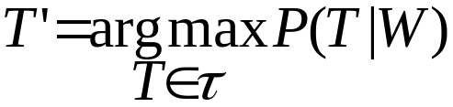
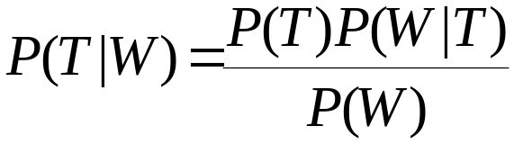
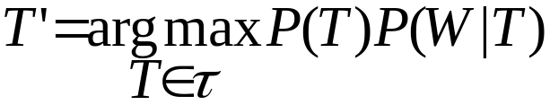
Statistical POS Tagging (whole sequence)
Goal: choose the best sequence of tags T for a sequence of words W in a sentence
  By Bayes Rule (giving us something easier to calculate)
  Since we can ignore P(W), we have

Slide 103
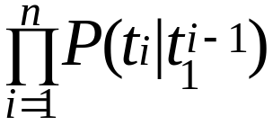

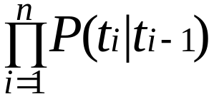
Statistical POS Tagging: the Prior
P(T) = P(t₁, t₂, …, t_{n-1} , t_{n})
By the Chain Rule: [P(t_{n} t_{n-1 ..}t₁)= P(t_{n} | t₁, …, t_{n-1} ) P(t₁, ... t_{n-1})
P(t_{n} t_{n-1 ..}t₁) = P(t_{n} | t₁, …, t_{n-1} ) P(t₁, …, t_{n-1})
=
Making the Markov assumption:
e.g., for bigrams,

Slide 104
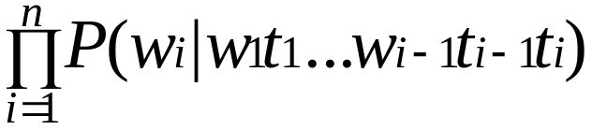
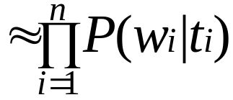
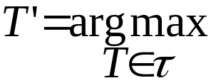
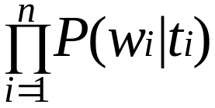
Statistical POS Tagging: the (Lexical) Likelihood
P(W|T) = P(w₁, w₂, …, w_{n} | t₁, t₂, …, t_{n} )
From the Chain Rule:
=
Simplifying assumption: probability of a word depends only on its own tag P(w_{i}|t_{i})
So...

Slide 105
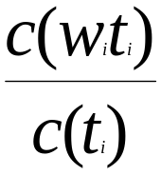
Estimate the Tag Priors and the Lexical Likelihoods from Corpus
Maximum-Likelihood Estimation
  For bigrams:
    P (t_{i}|t_{i-1}) = c(t_{i-1}, t_{i} )/c(t_{i-1} )
    P(w_{i}| t_{i}) =

Slide 106
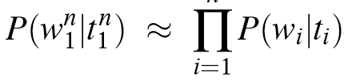
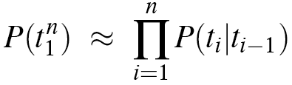
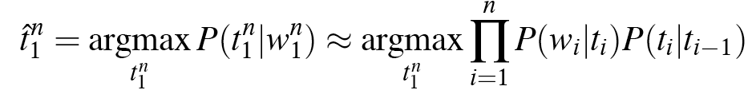
Likelihood and prior
Further Simplifications
1. the probability of a word appearing depends only on its own POS tag, i.e, independent of other words around it
n
P(A,B)=P(A) · P(B) iff A,B independent.
P(H,T) = P(heads) · P(tails) = .5 · .5 = .25
2. BIGRAM assumption: the probability of a tag appearing depends only on the previous tag
P(t1t2...tn)=P(t1 and t2|t1 and t3|t2 and... and tn|tn-1)
3. The most probable tag sequence estimated by the bigram tagger
Natural Language Processing

Slide 107
Likelihood and prior
Further Simplifications
1. the probability of a word appearing depends only on its own POS tag, i.e, independent of other words around it
n
WORDS
TAGS
the
koala
put
the
keys
on
the
table
N
V
P
DET
Natural Language Processing
Notes:
The Cartesian product of two sets X and Y, denoted X x Y, is the set of all possible ordered pairs whose first component is a member of X and whose second component is a member of Y
Capital Pi: the Cartesian product over an arbitrary (possibly infinite) collection of sets

Slide 108
Likelihood and prior
Further Simplifications
2. BIGRAM assumption: the probability of a tag appearing depends only on the previous tag
Bigrams are groups of two written letters, two syllables, or two words; they are a special case of N-gram.
Bigrams are used as the basis for simple statistical analysis of text
The bigram assumption is related to the first-order Markov assumption
Natural Language Processing

Slide 109
Likelihood and prior
Further Simplifications
3. The most probable tag sequence estimated by the bigram tagger
---------------------------------------------------------------------------------------------------------------
n
biagram assumption
Natural Language Processing

Slide 110
Two kinds of probabilities (1)
Tag transition probabilities p(t_{i}|t_{i-1})
  Determiners likely to precede adjs and nouns
    That/DT flight/NN
    The/DT yellow/JJ hat/NN
    So we expect P(NN|DT) and P(JJ|DT) to be high
    But P(DT|JJ) to be:?
Natural Language Processing

Slide 111
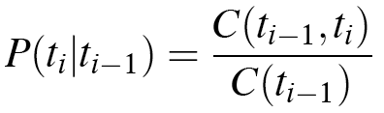
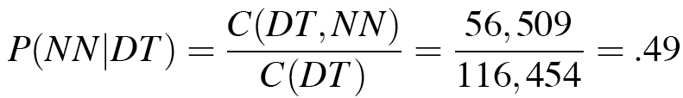
Two kinds of probabilities (1)
Tag transition probabilities p(t_{i}|t_{i-1})
  Compute P(NN|DT) by counting in a labeled corpus:
# of times DT is followed by NN
Natural Language Processing

Slide 112
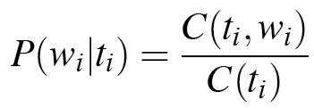
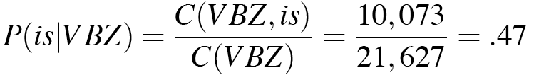
Two kinds of probabilities (2)
Word likelihood probabilities p(w_{i}|t_{i})
  P(is|VBZ) = probability of VBZ (3sg Pres verb) being “is”
  Compute P(is|VBZ) by counting in a labeled corpus:
If we were expecting a third person singular verb, how likely is it that
this verb would be is?
Natural Language Processing

Slide 113
An Example: the verb “race”
Secretariat/NNP is/VBZ expected/VBN to/TO race/VB tomorrow/NR
People/NNS continue/VB to/TO inquire/VB the/DT reason/NN for/IN the/DT race/NN for/IN outer/JJ space/NN
How do we pick the right tag?
Natural Language Processing

Slide 114
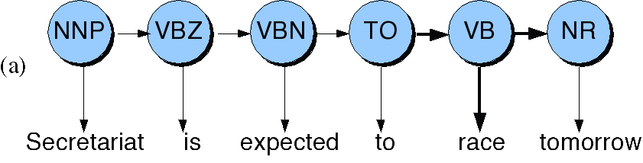
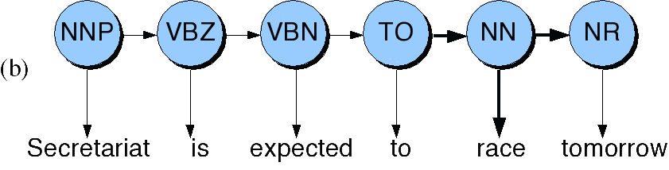
Disambiguating “race”
Natural Language Processing

Slide 115
Disambiguating “race”
P(NN|TO) = .00047
P(VB|TO) = .83
The tag transition probabilities P(NN|TO) and P(VB|TO) answer the question: ‘How likely are we to expect verb/noun given the previous tag TO?’
P(race|NN) = .00057
P(race|VB) = .00012
Lexical likelihoods from the Brown corpus for ‘race’ given a POS tag NN or VB.
P(NR|VB) = .0027
P(NR|NN) = .0012
tag sequence probability for the likelihood of an adverb occurring given the previous tag verb or noun
P(VB|TO)P(NR|VB)P(race|VB) = .00000027
P(NN|TO)P(NR|NN)P(race|NN)=.00000000032
Multiply the lexical likelihoods with the tag sequence probabiliies: the verb wins
Natural Language Processing

Slide 116
Further Problems
Unknown words are a problem since we don’t have the required probabilities. Possible solutions:
  Assign the word probabilities based on corpus-wide distribution of POS
  Use morphological cues (capitalization, suffix) to assign a more calculated guess.
Using higher order Markov models:
  Using a trigram model captures more context
  However, data sparseness is much more of a problem.
Natural Language Processing

Slide 117
Evaluation of POS taggers
compared with gold-standard of human performance
metric:
  accuracy = % of tags that are identical to gold standard
most taggers ~96-97% accuracy
must compare accuracy to:
  ceiling (best possible results)
    how do human annotators score compared to each other? (96-97%)
    so systems are not bad at all!
  baseline (worst possible results)
    what if we take the most-likely tag (unigram model) regardless of previous tags ? (90-91%)
    so anything less is really bad
Natural Language Processing

Slide 118
More on tagger accuracy
is 95% good?
  that’s 5 mistakes every 100 words
  if on average, a sentence is 20 words, that’s 1 mistake per sentence
when comparing tagger accuracy, beware of:
  size of training corpus
    the bigger, the better the results
  difference between training & testing corpora (genre, domain…)
    the closer, the better the results
  size of tag set
    Prediction versus classification
  unknown words
    the more unknown words (not in dictionary), the worst the results
Natural Language Processing

Slide 119
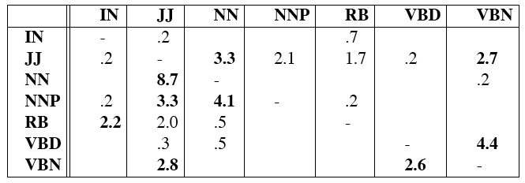
Error Analysis
Look at a confusion matrix (contingency table)
E.g. 4.4% of the total errors caused by mistagging VBD as VBN
See what errors are causing problems
  Noun (NN) vs ProperNoun (NNP) vs Adj (JJ)
  Adverb (RB) vs Particle (RP) vs Prep (IN)
  Preterite (VBD) vs Participle (VBN) vs Adjective (JJ)
ERROR ANALYSIS IS ESSENTIAL!!!
Natural Language Processing

Slide 120
Major difficulties in POS tagging
Unknown words (proper names)
  because we do not know the set of tags it can take
  and knowing this takes you a long way (cf. baseline POS tagger)
  possible solutions:
    assign all possible tags with probabilities distribution identical to lexicon as a whole
    use morphological cues to infer possible tags
      ex. word ending in -ed are likely to be past tense verbs or past participles
Frequently confused tag pairs
  preposition vs particle
    <running> <up> a hill (prep) / <running up> a bill (particle)
  verb, past tense vs. past participle vs. adjective
Natural Language Processing

Slide 121
Unknown Words
Most-frequent-tag approach.
What about words that don’t appear in the training set?
Suffix analysis:
  The probability distribution for a particular suffix is generated from all words in the training set that share the same suffix.
Suffix estimation – Calculate the probability of a tag t given the last i letters of an n letter word.
Smoothing: successive abstraction through sequences of increasingly more general contexts (i.e., omit more and more characters of the suffix)
Use a morphological analyzer to get the restriction on the possible tags.
Natural Language Processing

Slide 122
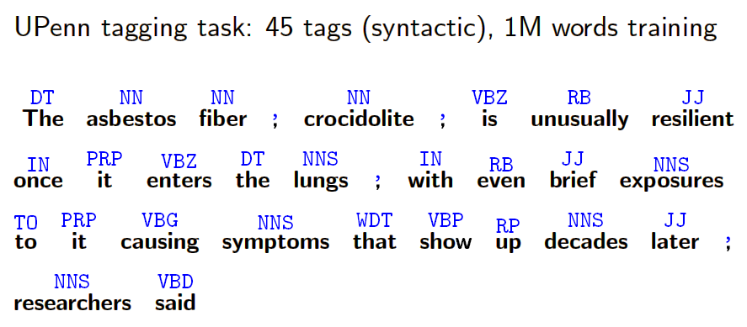
POS tagging Experiments
Natural Language Processing

Slide 123
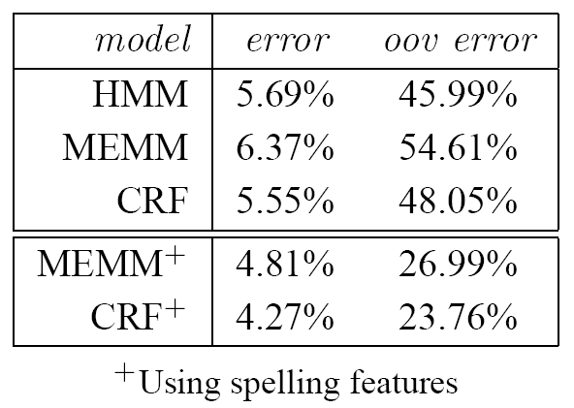
POS tagging Experiments (cont’d)
Compared HMMs, MEMMs, and CRFs on Penn treebank POS tagging
Each word in a given input sentence must be labeled with one of 45 syntactic tags
Add a small set of orthographic features: whether a spelling begins with a number or upper case letter, whether it contains a hyphen, and if it contains one of the following suffixes: -ing, -ogy, -ed, -s, -ly, -ion, -tion, -ity, -ies
oov = out-of-vocabulary (not observed in the training set)
Natural Language Processing

Slide 124
State of the art
https://aclweb.org/aclwiki/POS_Tagging_(State_of_the_art)
Natural Language Processing

Slide 125
MULTUMESC!
Tesekkur ederim!

